Slide 1
ALTO Re-charter Item: Multidomain ALTO
IETF 109, Virtual (Bangkok) Event
Nov. 19, 2020

Slide 2
Problem (Relevance)
RFC 7971: "The ALTO protocol is designed for use cases where the ALTO server and client can be located in different organizations or trust domains. ALTO is inherently designed for use in multi-domain environments. Most importantly, ALTO is designed to enable deployments in which the ALTO server and the ALTO client are not located within the same administrative domain. ”
But existing core ALTO services including Endpoint Cost Service (ECS) and Cost Map Service query a single ALTO server for the ALTO properties (e.g., routing cost, latency, …) of the whole network path, but the path may span multiple networks served by multiple ALTO servers.
Multiple projects (e.g., [1][2]) identify systematic multi-domain design as a key missing feature of ALTO.
[1] https://datatracker.ietf.org/doc/draft-lachos-alto-multi-domain-use-cases/ [2] https://datatracker.ietf.org/doc/draft-xiang-alto-multidomain-analytics/

Slide 3
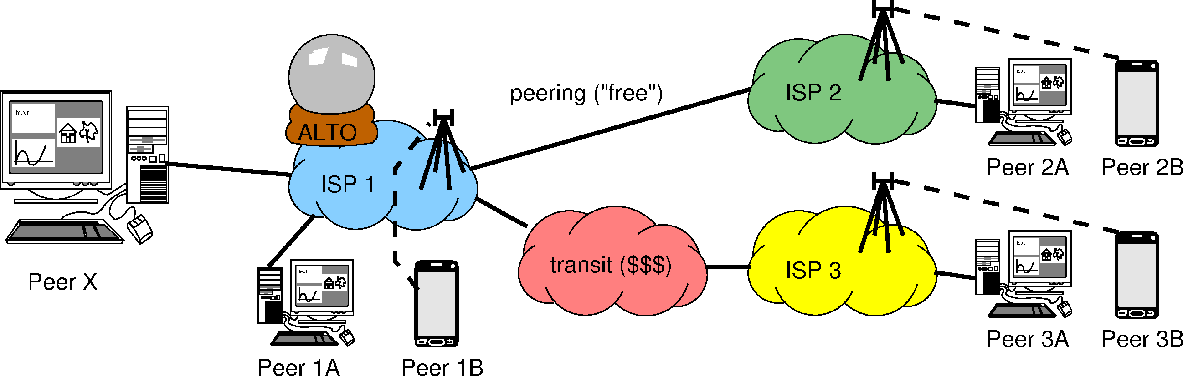


Problem (Relevance)
Which guidance should ISP 1 give to Peer X (based on relative preference)?
Peer 1A
Peer 1B
Peer 2A, 2B (*)
Peer 3A, 3B (*)
Peer 1A
Peer 2A, 2B (*)
Peer 1B
Peer 3A, 3B (*)
(*) = ?A and ?B are on the same level of preference, because ISP1 might not know that they are wireline vs. wireless, doesn’t care (monetary cost is the same for ISP1), and/or wouldn’t dare to tell even if they knew
Is “all within my domain” or “not in my
wireless network” more preferable?
Sebastian Kiesel presentation on Sept. 30, 2020
ALTO
2020-09-30 ietf-alto@skiesel.de

Slide 4
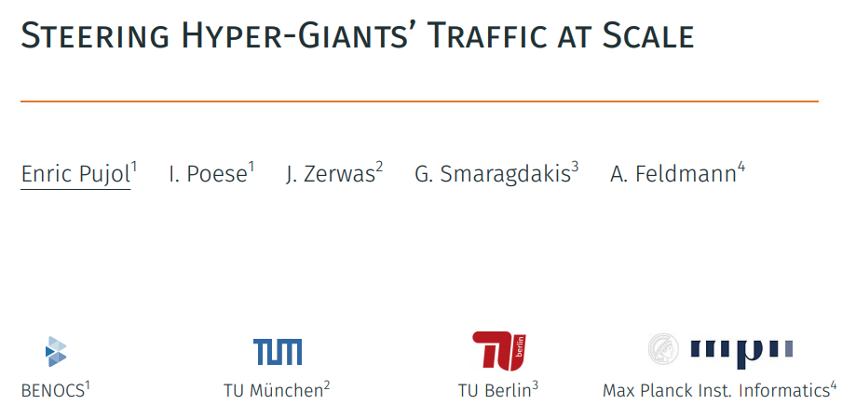
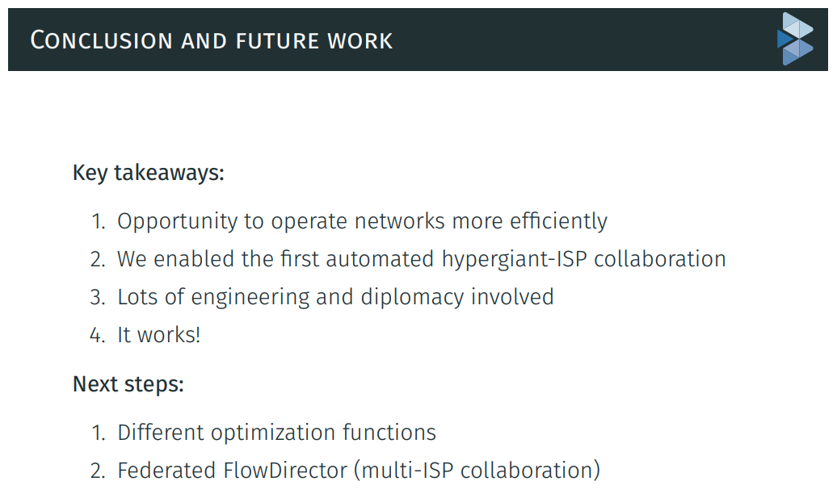
Problem (Relevance)

Slide 5
A Potential Solution (Feasibility)
WG discussed at least one reasonably well-understood, feasible architecture called ALTO Multi-Domain Abstractions (MDA)
The path of a flow from a src to a dst consists of a sequence (vector) of segments from multiple networks
src -> net₁-e -> net₂-i -> … -> net_{i}-e -> net_{i+1}-i -> … -> net_{n}-e -> dst
The cost of a path is a vector corresponding to the vector of segments
The paths of a set of flows form a flow graph
Constructed by merging shared egress or ingress nodes of the segments
net₁-e
net₂-i
net_{n}-e
src
dst

Slide 6
Simple ALTO Extensions to Realize ALTO MDA
Ext 1: Segment discovery
<flow, netid:ingress> -> <netid:egress, netid:next-ingress; [Sebastian proposal: next-alto-server-uri; handle blackhole…]>
Ext 2: Path cost discovery (extend ECS/cost map service, …)
<segment-set, metric> -> <cost>
Operation models for extensions [mechanisms, not policies]
iterative (client aggregation)
recursive (network helped aggregation)
hybrid

Slide 7
Remaining (Engineering) Issues
A vector of path cost may no longer defines a total order; candidate designs MUST discuss clear guidelines to applications on how to utilize partial ordering, and the consequences (i.e., operations considerations)
Leverage SIGCOMM’20 multi-criteria routing design
Incremental deployment: the chaining of domains may be broken due to incremental deployment (e.g., domain sequence is S -> A -> B -> C -> D, but C does not provide ALTO server)
Need to fix broken chains (e.g., proxy server based on BGP observation)
Need to discuss incentive for missing networks to deploy

Slide 8
Related References on Multidomain
https://datatracker.ietf.org/doc/draft-lachos-alto-multi-domain-use-cases/
https://datatracker.ietf.org/doc/draft-lachos-sfc-multi-domain-alto/
https://datatracker.ietf.org/doc/draft-lachosrothenberg-alto-brokermdo/
https://datatracker.ietf.org/doc/draft-lachosrothenberg-alto-md-e2e-ns/
CERN use case
https://datatracker.ietf.org/doc/draft-xiang-alto-multidomain-analytics/
https://ieeexplore.ieee.org/abstract/document/8756056
https://www.sciencedirect.com/science/article/abs/pii/S0167739X18302413
Inter-ALTO communication protocol
https://datatracker.ietf.org/doc/draft-dulinski-alto-inter-alto-protocol/
ALTO network-server, server-server API
https://datatracker.ietf.org/doc/draft-medved-alto-svr-apis/

Slide 9
Details: Who Will Work on It
Y. Richard Yang, Yale U.
Sebastian Kiesel, U. Stuttgart
Kai Gao, SCU
Bojre Ohlman, Ericsson
Danny Perez, Unicamp
Ingmar Poese, Benocs
Harvey Newman, CalTech/CERN and the GNA-G DIS WG
Qiao Xiang, XMU

Slide 10
Details: Potential Milestones (1-2 years)
Now - Mar. 2021: Presentations and meetings to clarify use cases and requirements at related venues including LHC, GNA-G DIS, panrg, PRP, …
Mar. 2021 (IETF 110): Initial draft containing use cases, requirements, preliminary design (e.g., ALTO MDA)
July 2021 (IETF 111): Prototyping of ALTO MDA and test
Nov. 2021 (IETF 112): Report prototyping results, complete specification, propose WG adoption
Mar. 2022 (IETF 113): Iteration
July 2022 (IETF 114): Submit to IESG

Slide 11
Proposed Paragraph
Extensions of ALTO services to support multi-domain settings. The current ALTO framework has made clear how to provide network information from a single ALTO server for a single network (administrative domain), but the network devices traversed by a flow can be managed by multiple networks that are not in the same domain. The working group will investigate and extend the ALTO framework to (1) specify multi-ALTO-server protocol flow and usage guidelines when an ALTO service involves network paths spanning multiple domains with multiple ALTO servers, and (2) extend or introduce ALTO services allowing east-west interfaces for multiple ALTO server integration and collaboration. The specification and extensions should use existing services whenever possible. The specification and extensions should consider realistic complexities including incremental deployment, dynamicity, and security issues including access control, authorization (e.g., an ALTO server provides information for a network that the server has no authorization), and privacy protection in multi-domain settings.

Slide 12
Backup Slides

Slide 13
IETF ALTO 2008 → RFC 7285 (2014)
ALTO protocol = one-way interface from the underlying IP network to an overlay, that is untrusted from network operator’s point of view, possibly unmanaged
P2P networks (BitTorrent)
Content Delivery Networks
The overlay nodes have only one “freedom of choice”: to which other overlay nodes (IP addresses) to connect and send/request data
Decision made in the endpoint of the data transmission
Decision made at a central location (e.g. BitTorrent tracker)
Incentive: the (postulated) “win-win situation”
Overlay network gets better performance
Cost-optimization in the underlying IP network → no price increase / no throttling for end-user
Traffic engineering in own network domain
Reduced cost for peering or upstream capacity
[Sebastian 9/30/2020]

Slide 14
Additional Questions
The “routing cost” metric makes it difficult to aggregate different point of views
See also RFC 8686, Appendix C
The “ALTO advice” runs in the opposite direction of the money
will it always stop at the peering points / Tier-1 carriers?
what if the advice given by ISP1’s ALTO server impairs ISP2’s traffic engineering?
will ISP1 be legally liable? Thus, will ISP1 refuse to give details wrt. ISP2 even if they knew?
[Sebastian 9/30/2020]

